Slide 1
Building Multi-language Reports for Power BI in 2023
Ted Pattison
Principal Program Manager
Power BI Customer Advisory Team (PBICAT)

Slide 2
Agenda
Building Multi-language Reports in Power BI
Creating and Testing Metadata Translations
Generating Machine Translations
Creating and Testing Report Label Translations
Creating a Workflow To Integrate Human Translations
Implementing Data Translations using Field Parameters
Implementing Data Translations for a Calendar Table

Slide 3
Building Multi-language Reports in Power BI
Power BI provides Internationalization and localization features
You can design report that render in English, Spanish, French and German
It's no longer necessary to copy/maintain a separate PBIX file per language
Building multi-language reports will decrease maintenance and overhead
Recent Power BI Enhancements for Building Multi-language Reports
USERCULTURE function now supported and used to create measures with dynamic translations
More properties for report visuals and shapes can be dynamically configured with measures
Introduction of Field Parameters offers much better options to implement data translations
This guidance is based on using an external tool named Translations Builder
Translations Builder designed to work together with Power BI Desktop
Translations Builder v1 originally published in July 2021
Translations Builder v2 published in January 2023 with significant productivity enhancements

Slide 4
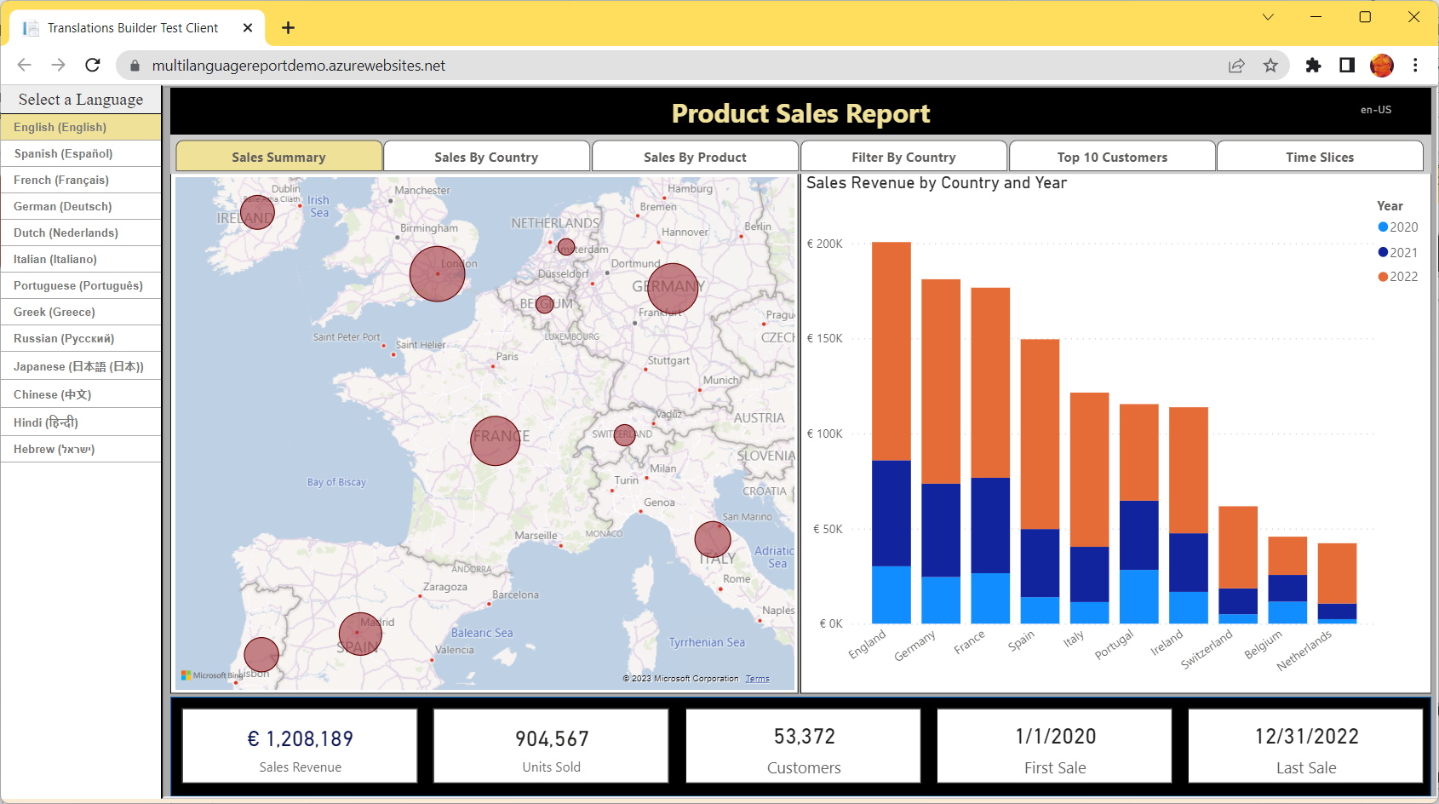
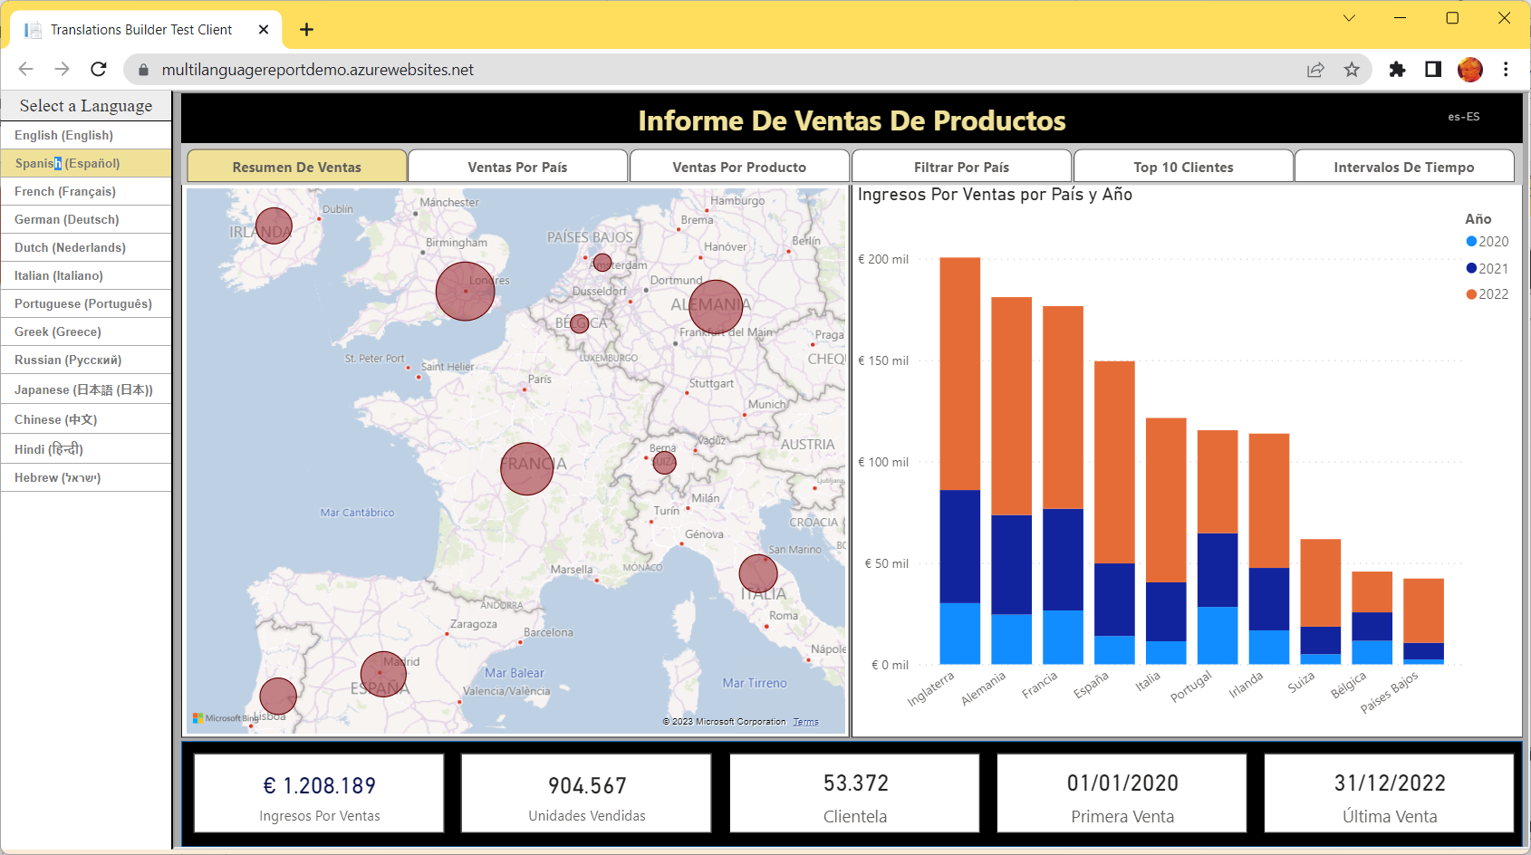
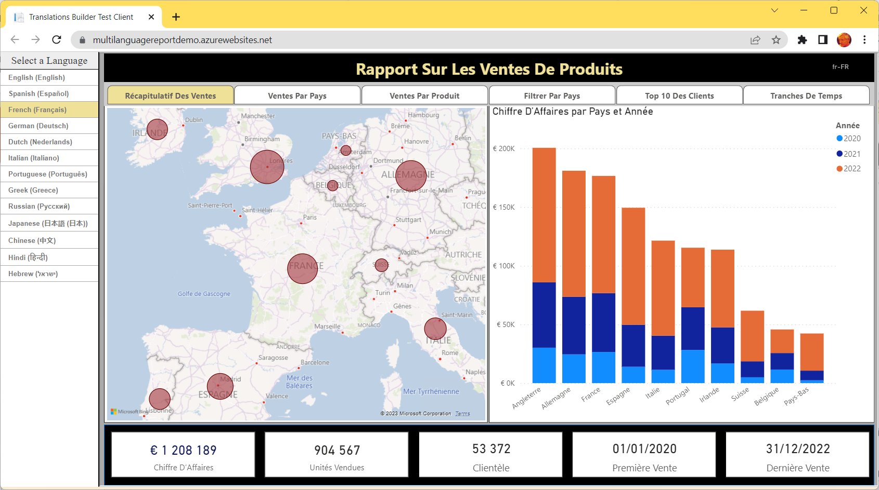
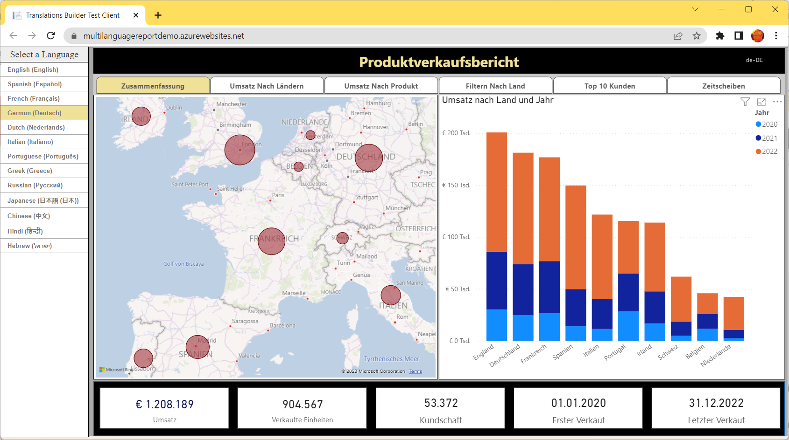
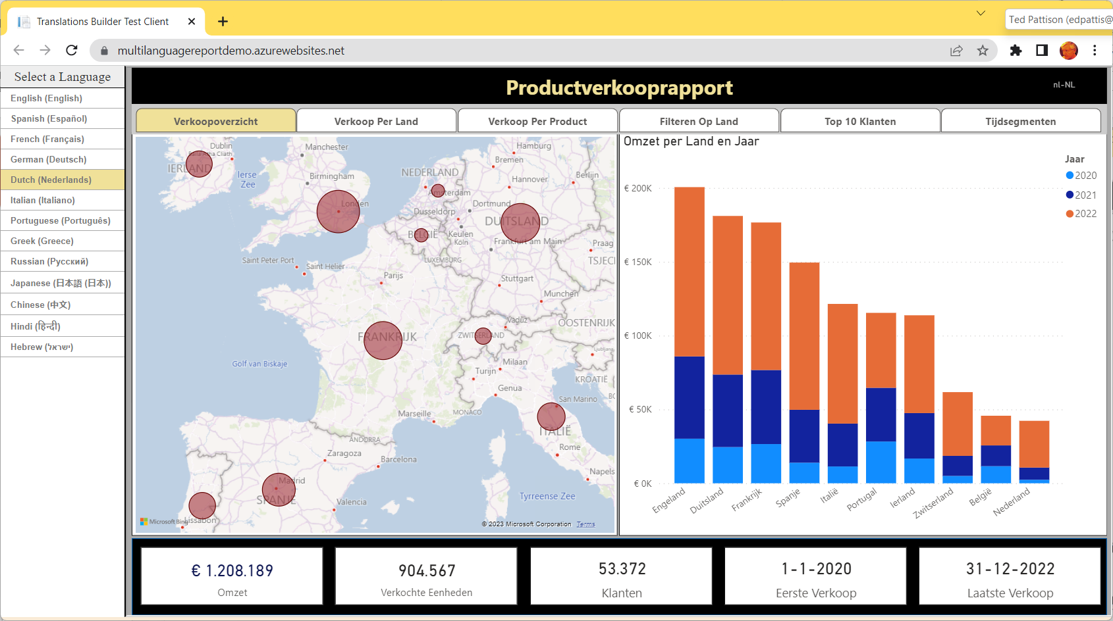
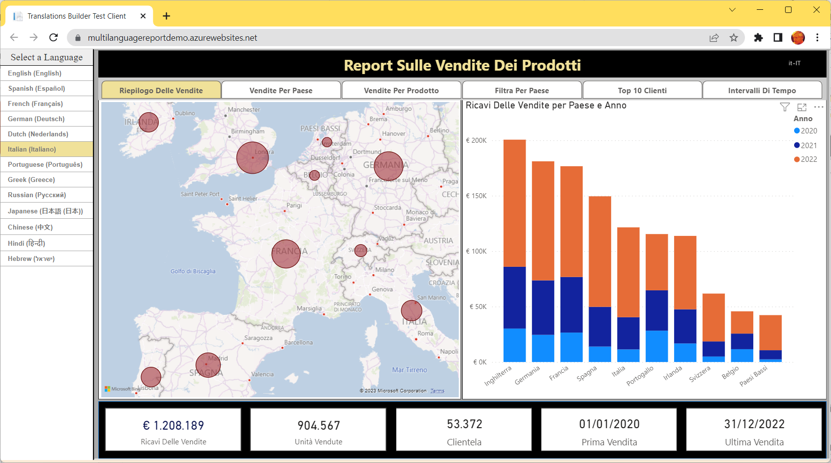
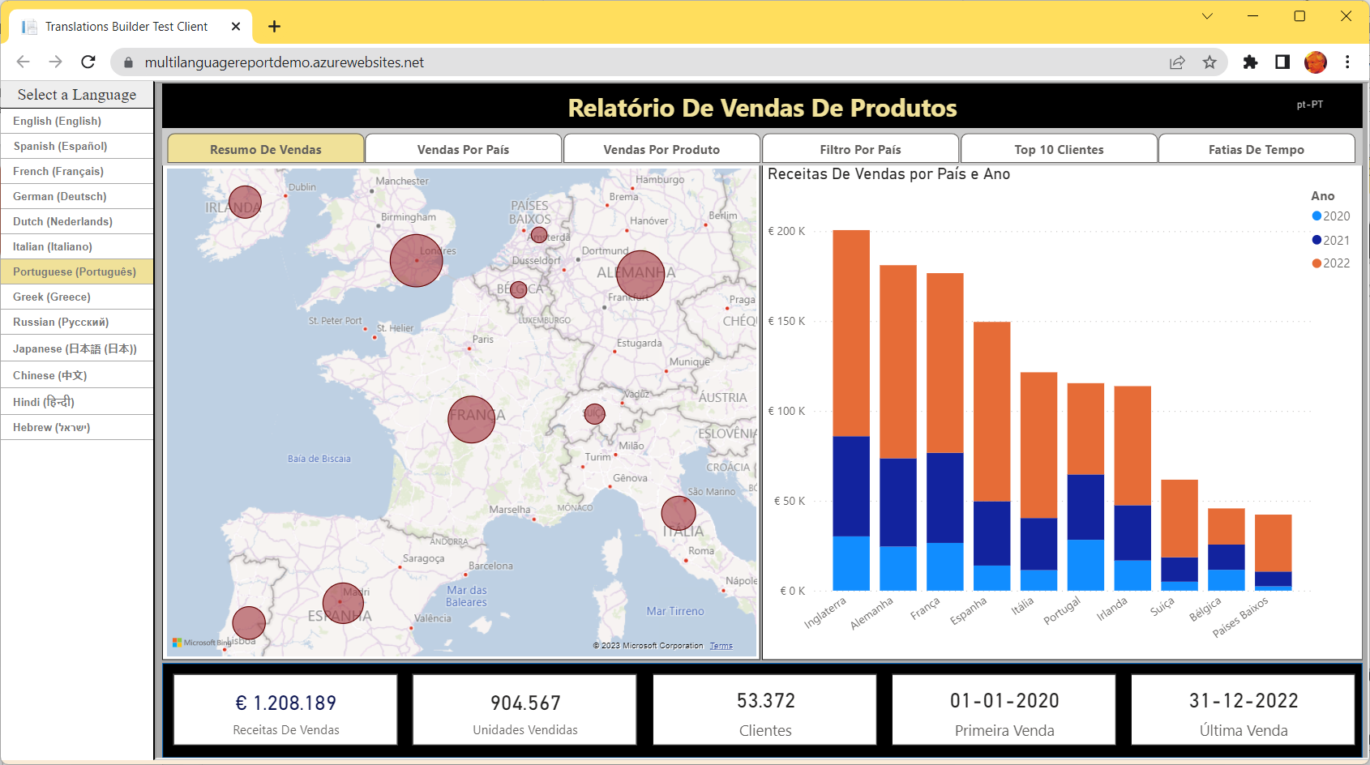
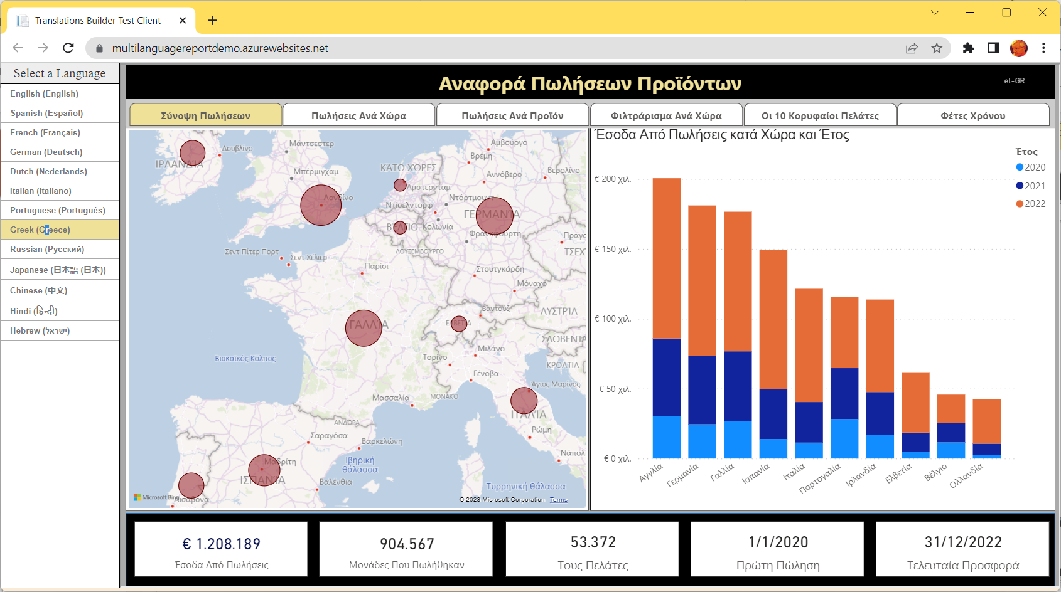
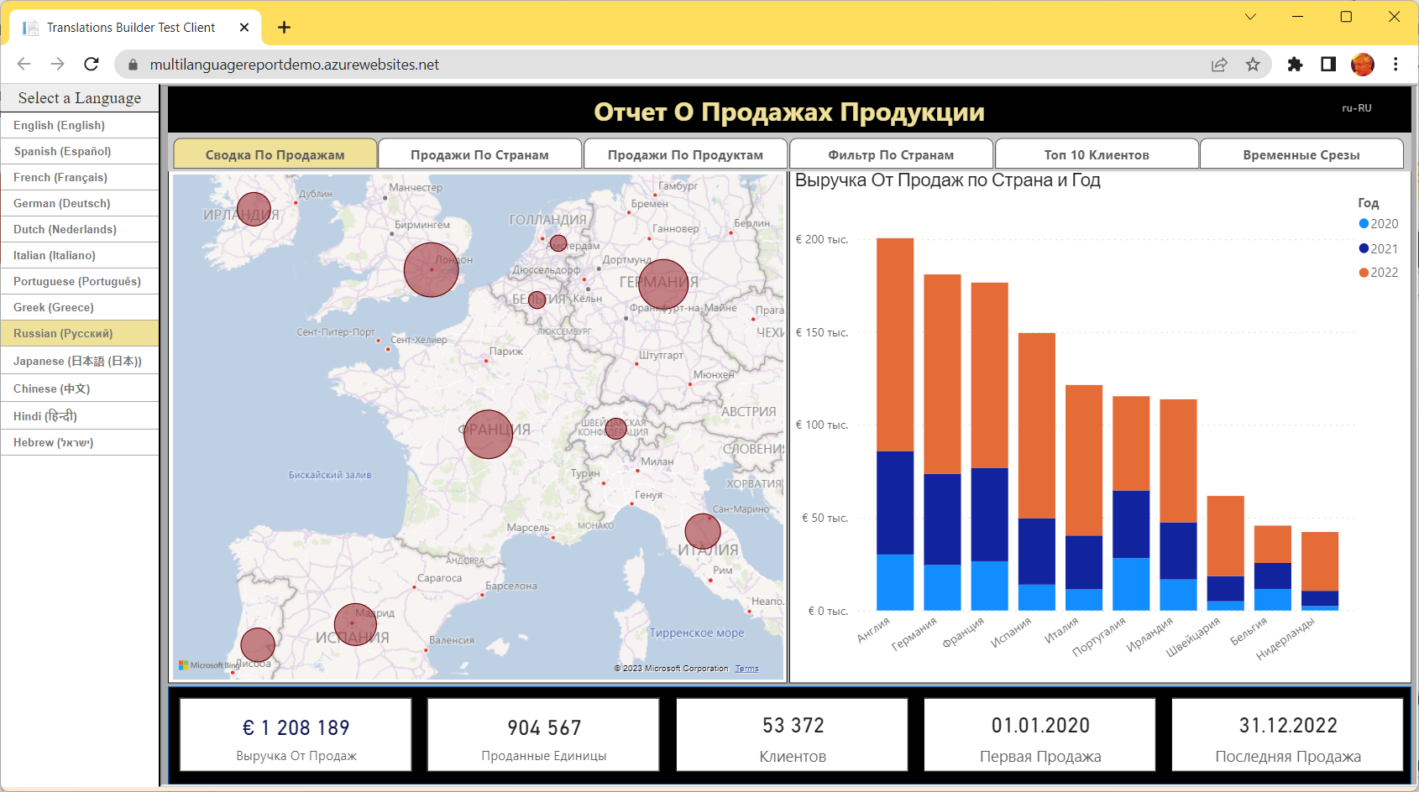
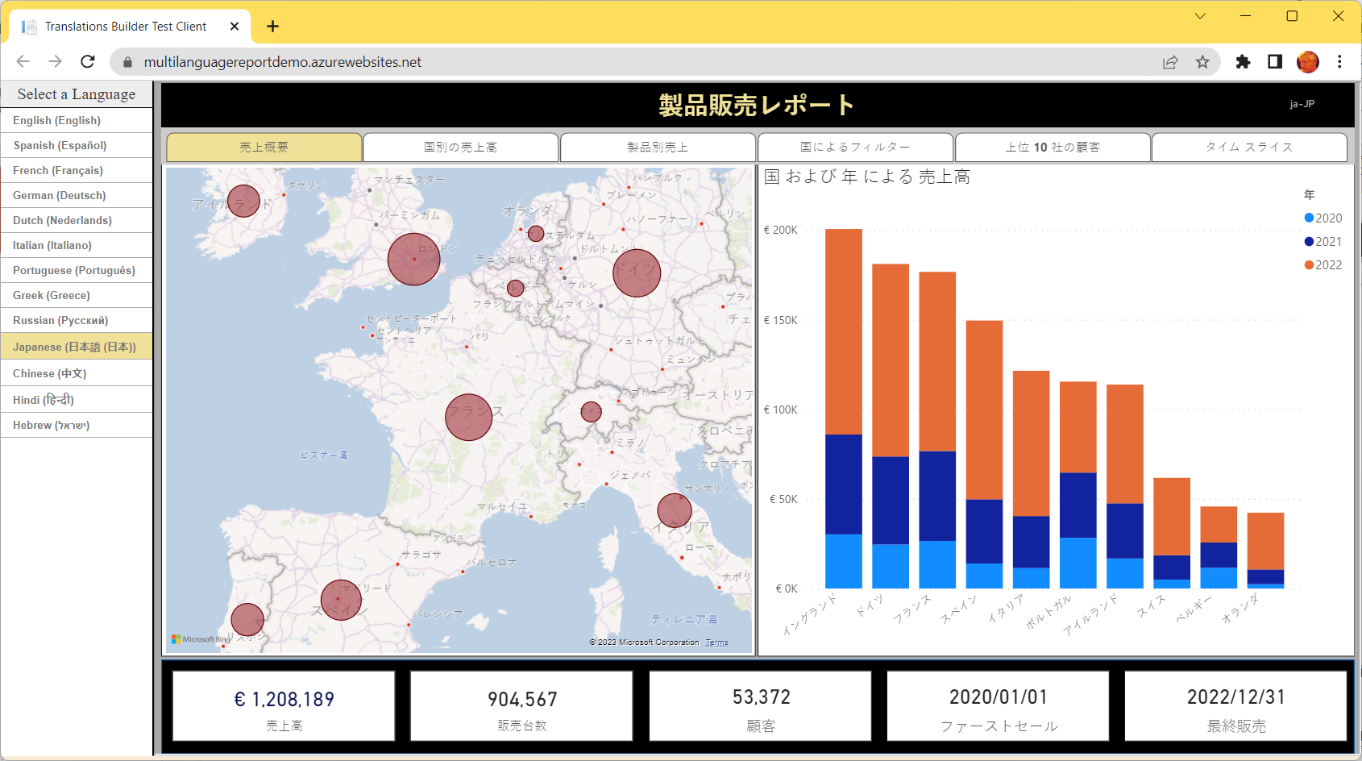
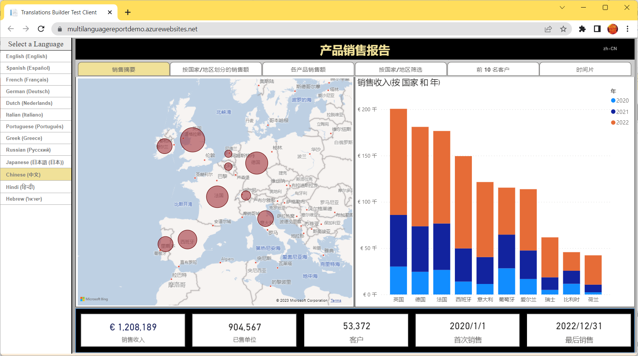
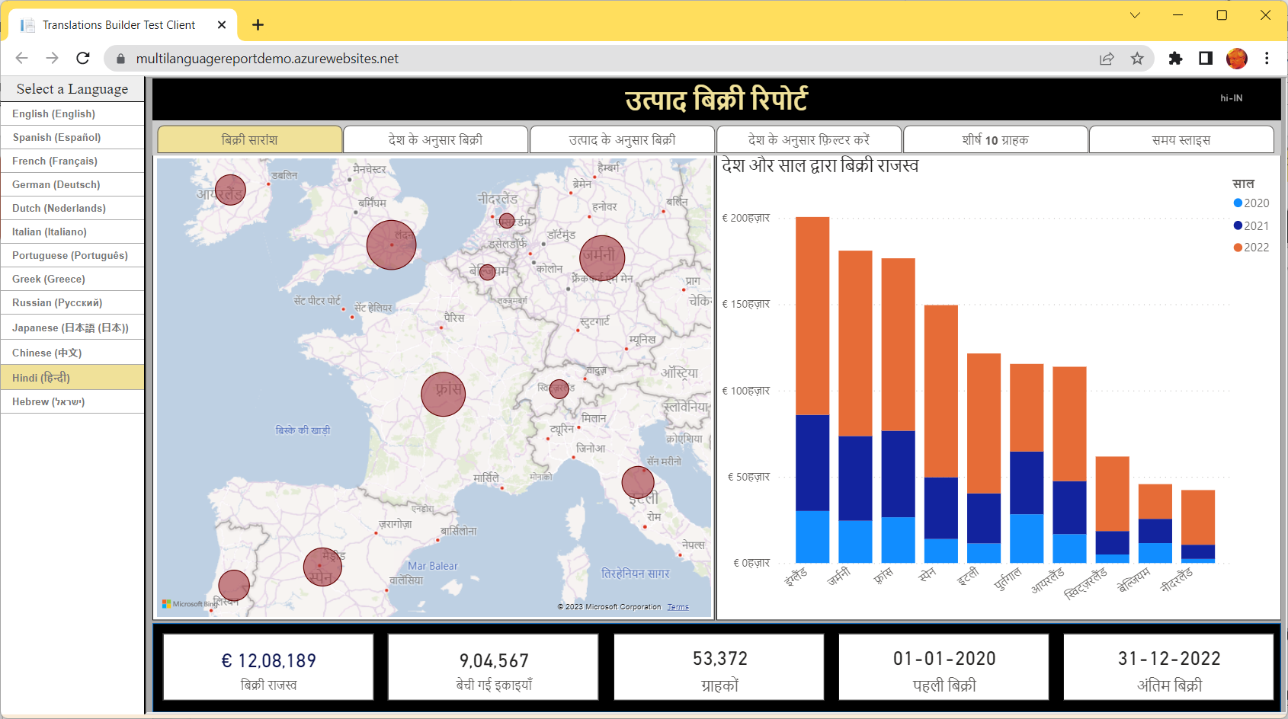
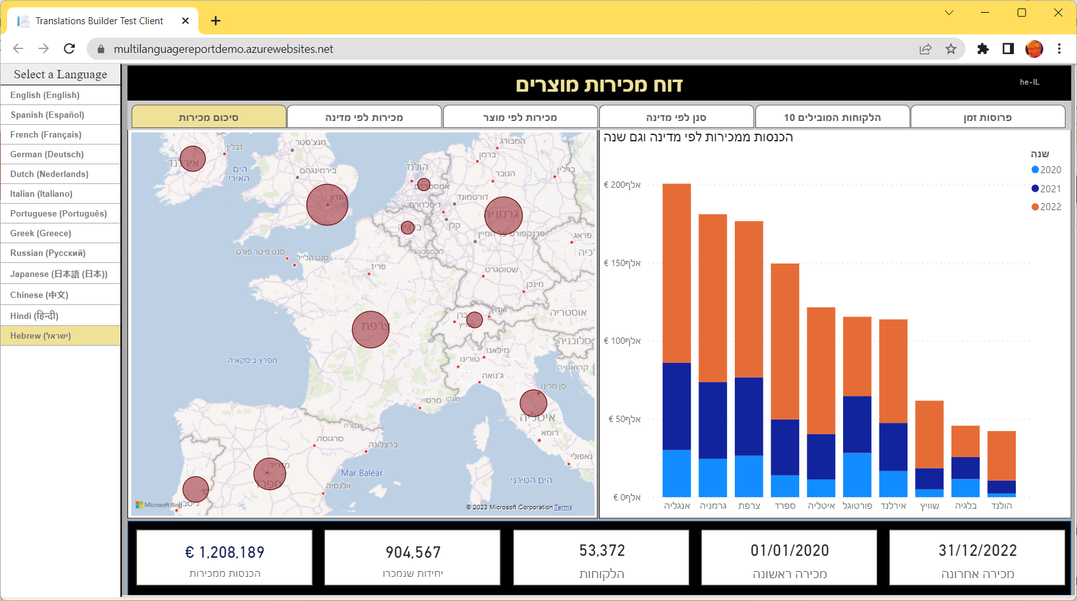
Multi-language Report Live Demo
https://multilanguagereportdemo.azurewebsites.net

Slide 5
Power BI Support for Metadata Translations
Power BI supports metadata translations for the properties of dataset objects
Supported object types include Table, Column, Measure, Hierarchy and Hierarchy Level
Supported object properties include Caption, Description and DisplayFolder
Metadata translations currently require Power BI Premium – not supported in shared capacity
Metadata translations only supported for Power BI datasets – not for report layouts
Report Layout does not support localization
Dataset Definition
supports localization
Metadata translations stored inside context of dataset definition
PBIX File (ProductSales.pbix)

Slide 6
Power BI Reports Load with Language and Locale of User
Every report loads with a specific language and a specific locale
Default behavior is to load report with language and locale of user’s browser settings
Language and locale setting can be overridden by adding language parameter to report URL
Language and locale setting can be controlled by developer with Power BI embedding
DAX recently added full support for USERCULTURE function
USERCULTURE returns a string with language and locale of current user
USERCULTURE | Language | Locale
en-US | English | United States
es-ES | Spanish | Spain
fr-FR | French | France
de-DE | German | Germany
Ja-JP | Japanese | Japan

Slide 7
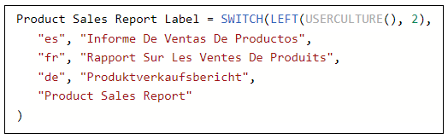
Implementing Dynamic Translations with USERCULTURE
Determine language of current user
Inspect the first two characters returned by USERCULTURE
Basic pattern for DAX expression to implement translations dynamically
Use SWITCH function with language identifier to dynamically return correct translation
Pattern falls back on the default language (en) when there is no match

Slide 8
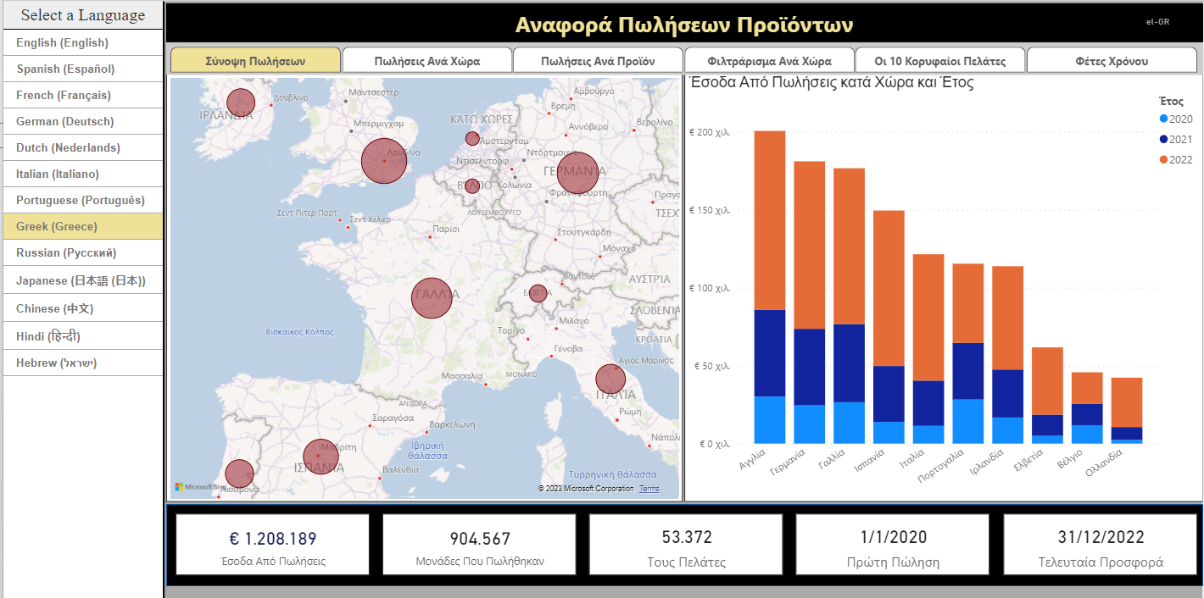
Determining the Language and Locale of Current User
Live demo and lab exercises display result of USERCULTURE to user in top banner
Included for content creators learning how build multi-language reports
Not something you would likely do in real production application

Slide 9
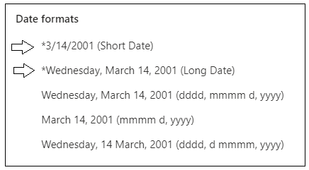
Formatting Dates and Numbers with Current User Locale
Power BI visuals inspect locale of current user when formatting numbers and dates
In most cases, visual will display values with correct formatting for current user’s locale
Make sure you use column and measure format strings that support regional formatting
Example of Short Date format string across different locales
en-US | 12/31/2022
en-GB | 31/12/2022
pt-PT | 31-12-2022
de-DE | 31.12.2022
ja-JP | 2022/12/31

Slide 10
Understanding the Three Types of Translations
Metadata translations (always required)
Translations for dataset object names such as tables, columns and measures
Report label translations (always required)
Translations for literal string values used in report
Provides localized text for report titles, section headings, button captions, etc.
Data Translations (sometimes required)
Translations of text-based column values in the rows of underlying data being analyzed

Slide 11
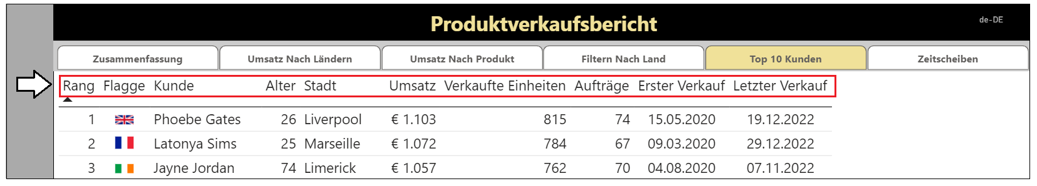
Metadata Translations for Columns and Measure Names
Metadata translations provide localized values for dataset object names
Metadata translations provide translated names for columns in a table
Metadata translations provide translated names for measures
Metadata translations are the easiest to create, manage and integrate into Power BI report

Slide 12
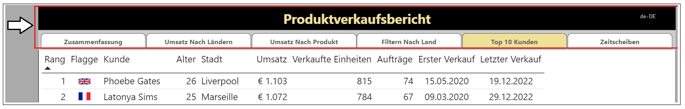
Report Label Translations
Report label translations provide localized values for text elements on report
Specifically for text elements not directly associated with a dataset object
Examples include the report title, section headings and button captions
Power BI provides no direct feature support for report labels translations
Best practice to implement report label translations by using USERCULTURE in dynamic measures

Slide 13
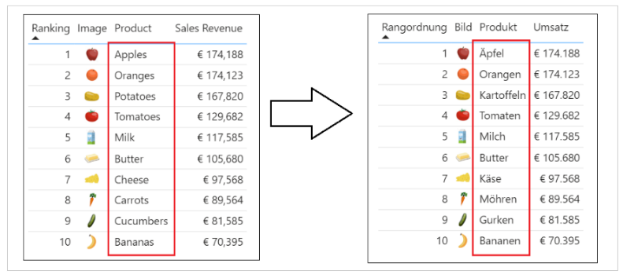
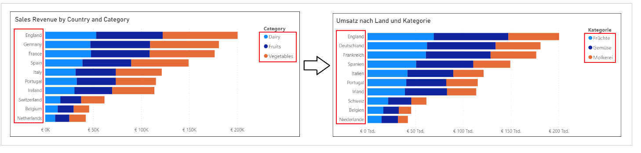
Data Translations
Data translations used to localize text values from underlying rows of data
Examples in the live demo include translated names for products, categories and countries
Data translations require the most effort to implement
It’s a best practice to implement data translations using the new Field Parameter feature

Slide 14
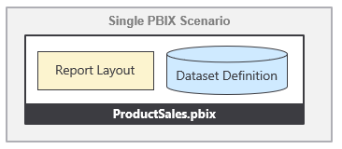
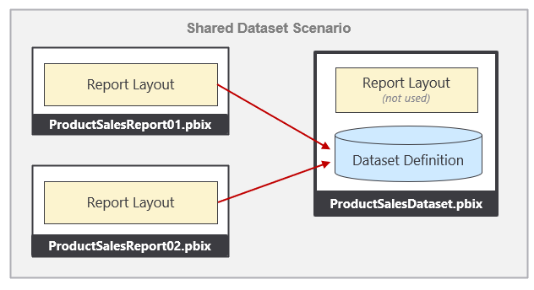
Packaging Dataset and Report in PBIX Project Files
There are two popular styles of managing datasets and reports in Power BI Desktop
Maintain dataset definition and report layout in a single PBIX project file for convenience
Split dataset definitions and report layout into separate PBIX project files
This guidance will work equally well with Style 1 and Style 2

Slide 15
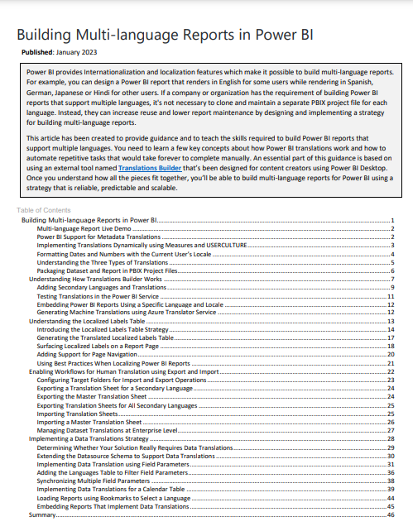
Guidance Document
Building Multi-language Reports in Power BI
https://aka.ms/MultiLanguageReportGuidance

Slide 16
Try Out Our New Hands-on Lab Exercises
Hands-on Lab: Building Multi-language Reports for Power BI
https://aka.ms/MultiLanguageReportLab
Sequence of lab exercises
Exercise 1: Creating and Testing Metadata Translations
Exercise 2: Generating Machine Translations
Exercise 3: Creating and Testing Report Label Translations
Exercise 4: Creating a Workflow Process To Gather and Integrate Human Translations
Exercise 5: Implementing Data Translations using Field Parameters
Exercise 6: Implementing Data Translations for a Calendar Table

Slide 17
Agenda
Building Multi-language Reports in Power BI
Creating and Testing Metadata Translations
Generating Machine Translations
Creating and Testing Report Label Translations
Creating a Workflow To Integrate Human Translations
Implementing Data Translations using Field Parameters
Implementing Data Translations for a Calendar Table

Slide 18

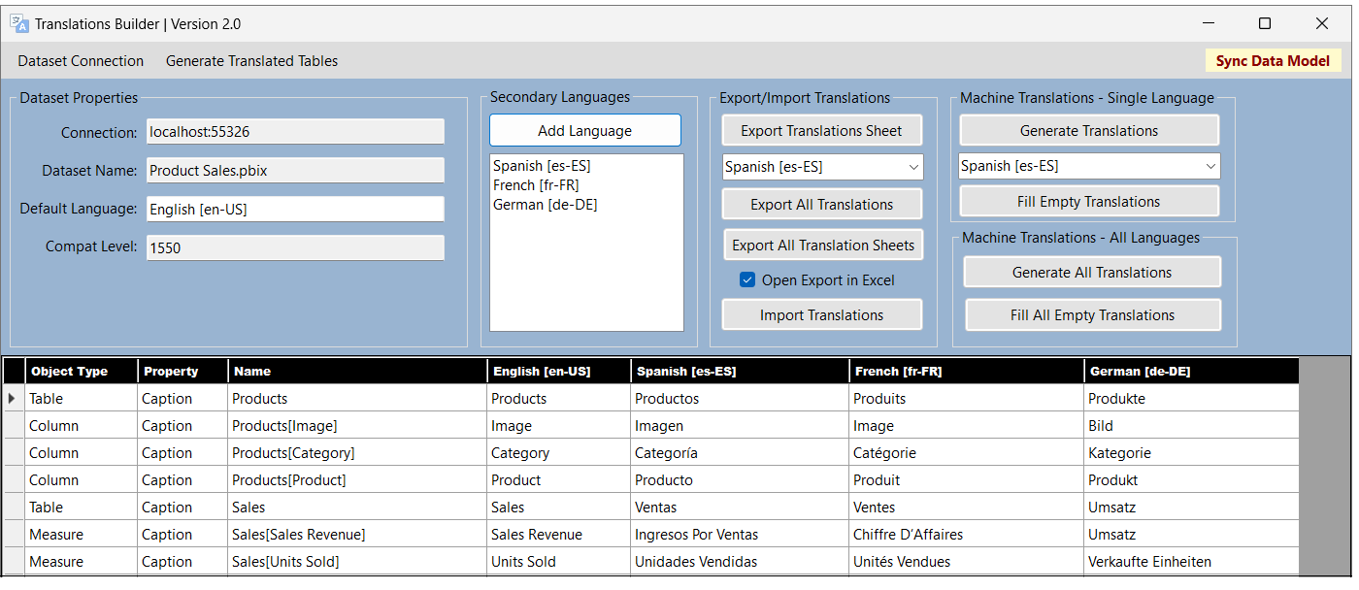
Working with Metadata Translations
Power BI Desktop does not expose metadata translations
It provides no capability to view, add or edit metadata translations
What are your options for working with metadata translations?
Use Tabular Editor to manually add and edit translations
Write scripts for Tabular Editor
Develop custom application with C# and Tabular Object Model (TOM)
Use Translations Builder – it was designed specifically to play this role

Slide 19
Translations Builder 2.0
Translations Builder is tool designed for content creators using Power BI Desktop
Content creators can use this tools to add multi-language support to PBIX project files
Provides support for working with (1) metadata translations and (2) report label translations

Slide 20
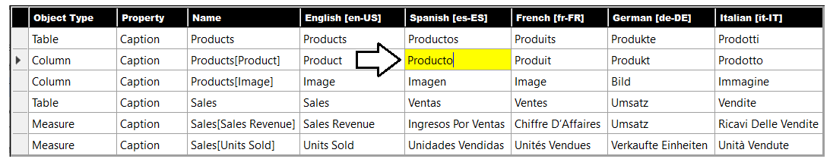
Working in the Translation Grid
Translations Builder user experience centers around translation grid
Abstracts away detail of read/writing object metadata to/from dataset
Allows user to view, add and update metadata translations using a two-dimensional grid
Provides simplified user editing experience similar to Microsoft Excel
Translations Builder
Power BI Dataset

Slide 21
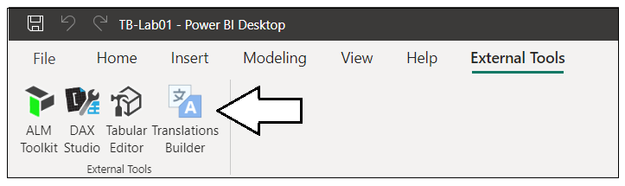
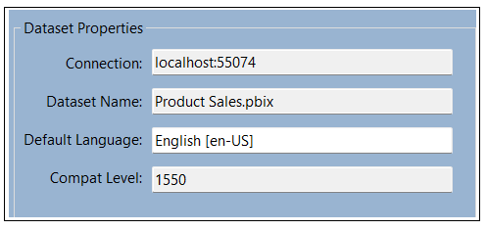
Launching Translations Builder
After installation, launch Translations Builder from External Tools tab
Translations Builder establishes connection back to dataset running in local AAS engine
Local Desktop Setup on Windows PC
Translations Builder
Power BI Desktop
Custom C# Code
Local Analysis Services Engine
Dataset
Tabular Object Model
localhost:55074
XMLA Endpoint
.NET Runtime

Slide 22
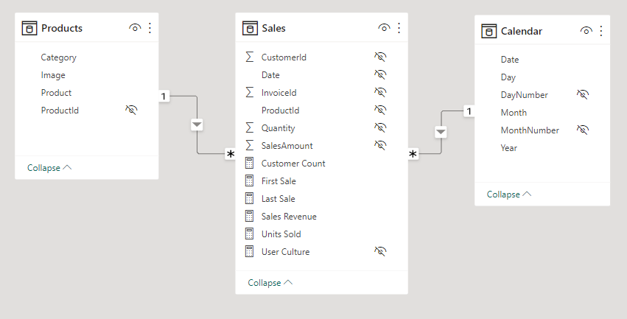
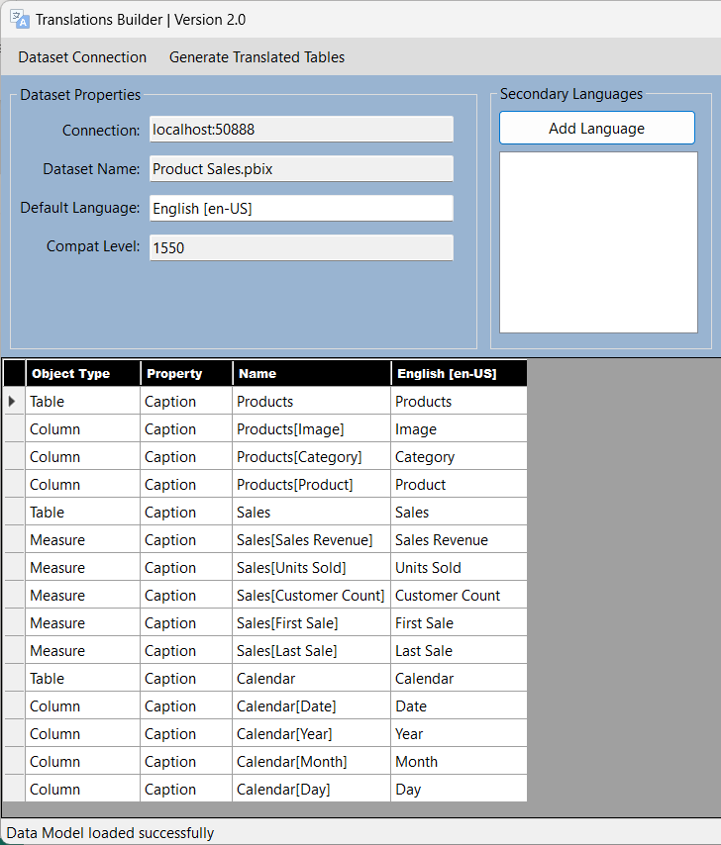
Loading the Data Model from PBIX Project
Translations Builder loads data model for PBIX project at startup
Translations Builder only loads dataset objects visible in Report view into translation grid
Hidden objects are not displayed because they do not require translation

Slide 23
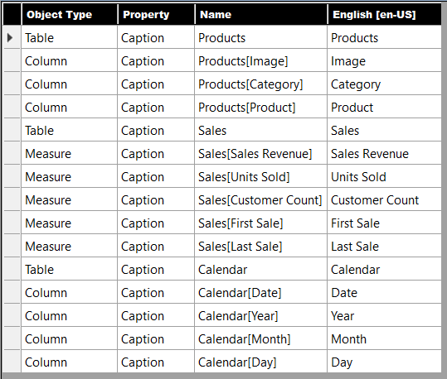
Understanding How Metadata Translations Are Identified
Metadata translations identified by combination of Object Type, Property and Name
Translations for Caption property is by far the most common
Translations for Description and DisplayFolder property not as common but can be used
Translations for default language (English) have object Name as their default value

Slide 24
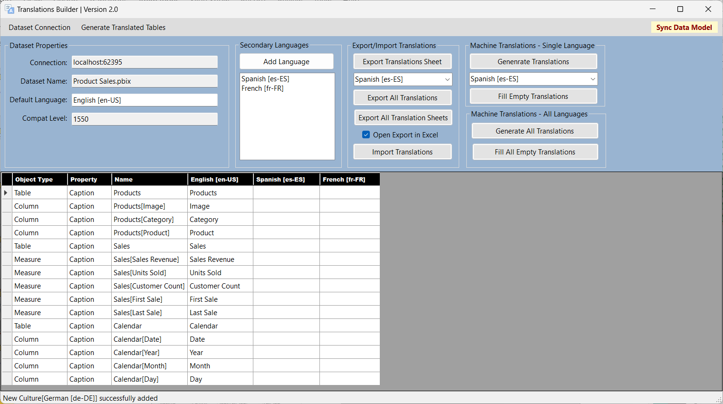
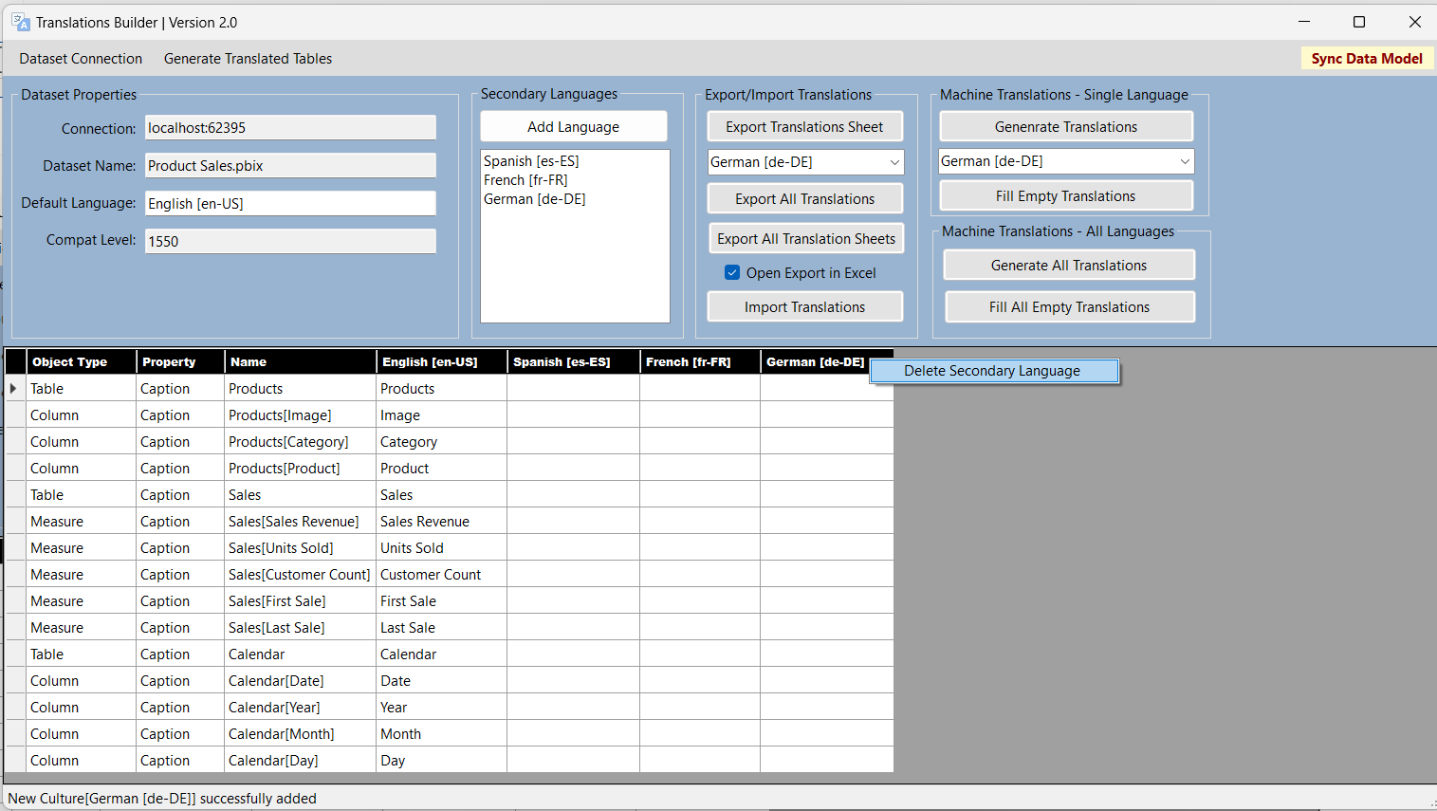
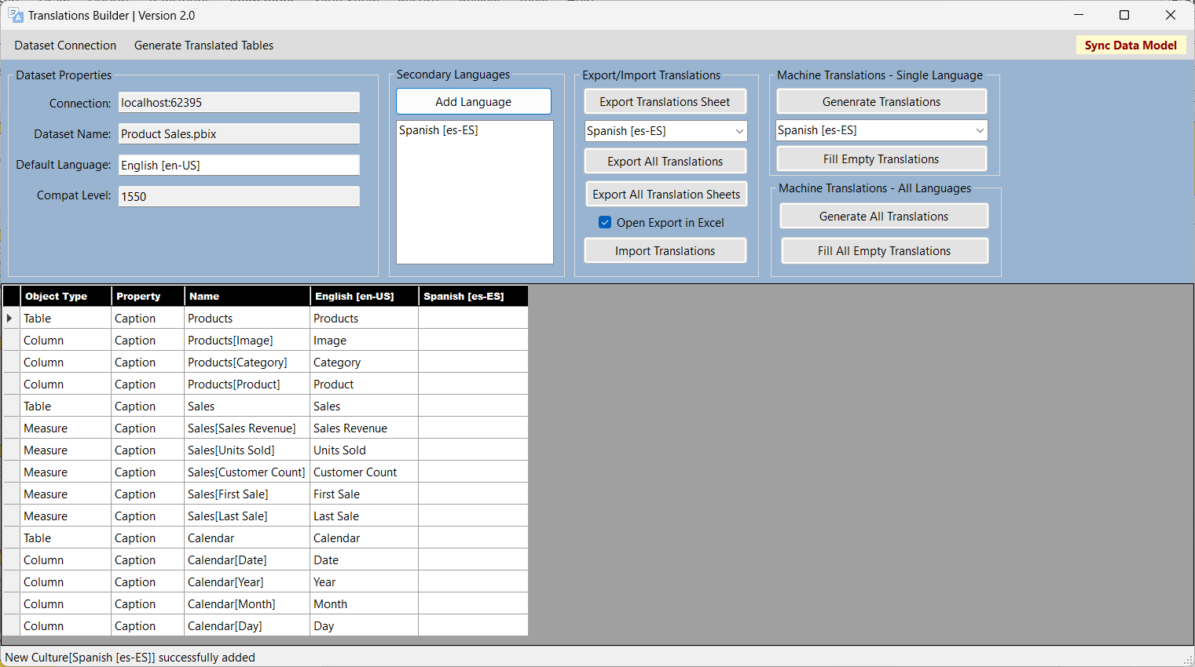
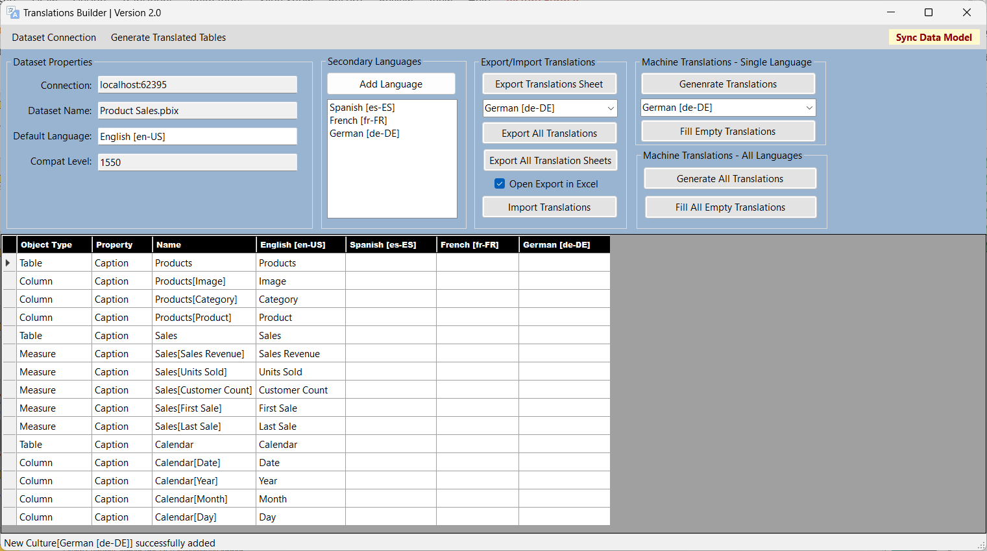
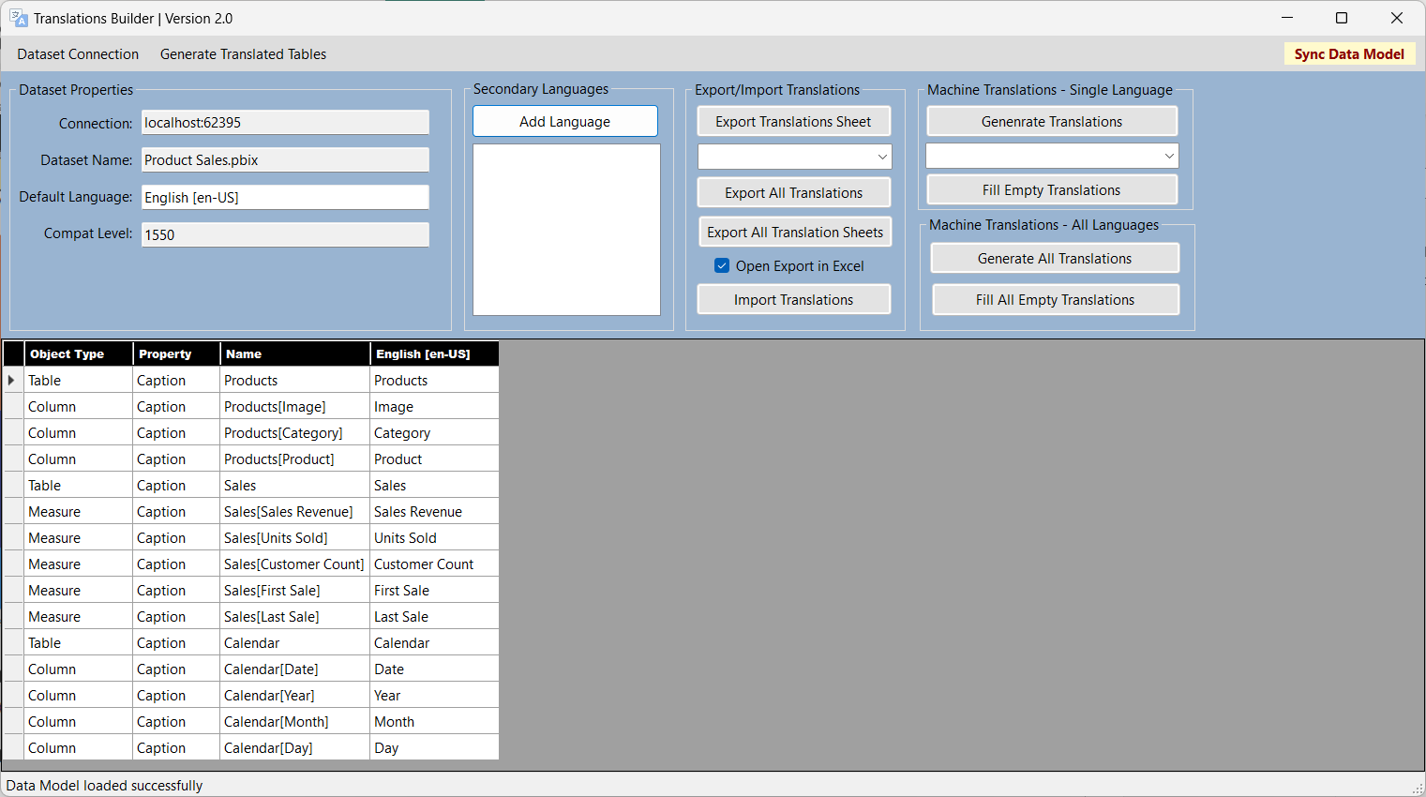
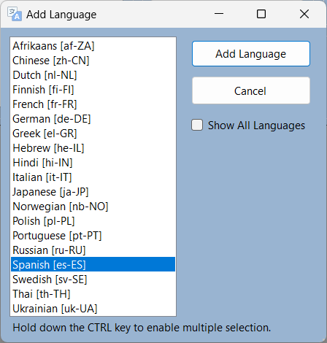
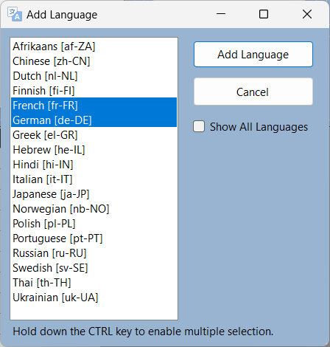
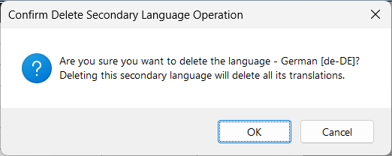
Adding Languages
Translations Builder provide commands for adding and removing languages

Slide 25
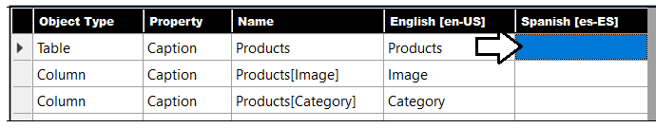
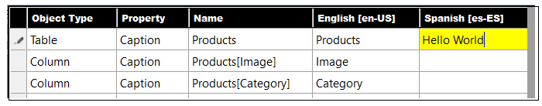
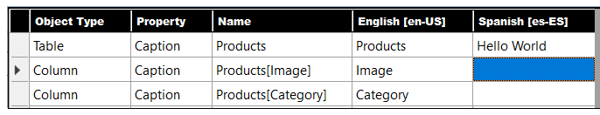
Adding and Editing Translations by Hand
Translation grid editing experience is similar to editing Microsoft Excel workbook
Select a cell
Begin typing
Press ENTER to move down to next cell

Slide 26
Testing Metadata Translations in Power BI Service
Metadata translations cannot be tested easily in Power BI Desktop
Analytics engine for Power BI Desktop does not load metadata translation
Dataset/report must be published to Power BI Service for testing
Workflow for Building Multi-language Reports
Add translations to dataset PBIX project file using Translations Builder
Save PBIX project file in Power BI Desktop and publish to the Power BI Service
Test translations in Power BI Service using language parameter on report URL
Repeat steps 1-3

Slide 27
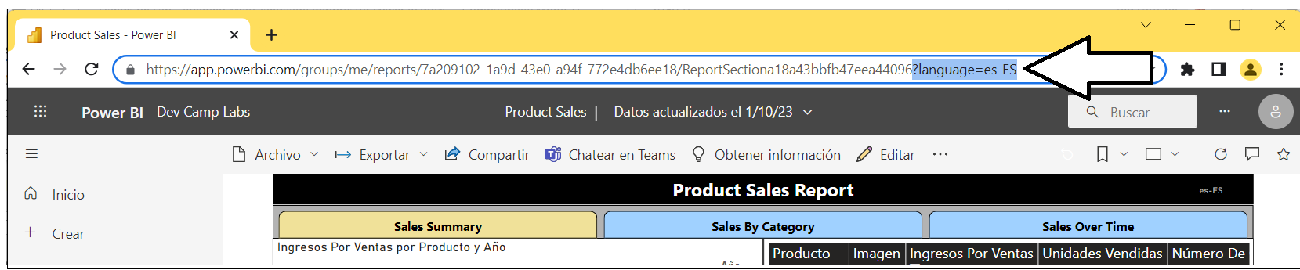
Testing with the language Parameter
Power BI Service determines user language and locale based on browser settings
Behavior can be overridden by adding language parameter to report URL
Setting language parameter allows you to test metadata translations for all languages

Slide 28
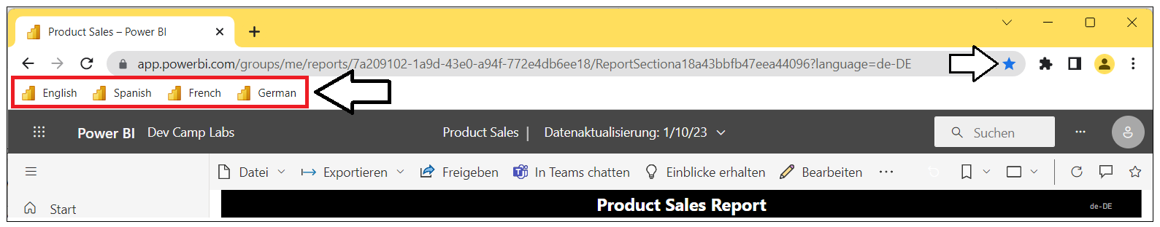
Helpful Tip: Add Browser Bookmarks For Testing
It can be helpful to create browser bookmarks for testing
One bookmark with language parameter in URL for each language in testing

Slide 29
Agenda
Building Multi-language Reports in Power BI
Creating and Testing Metadata Translations
Generating Machine Translations
Creating and Testing Report Label Translations
Creating a Workflow To Integrate Human Translations
Implementing Data Translations using Field Parameters
Implementing Data Translations for a Calendar Table

Slide 30
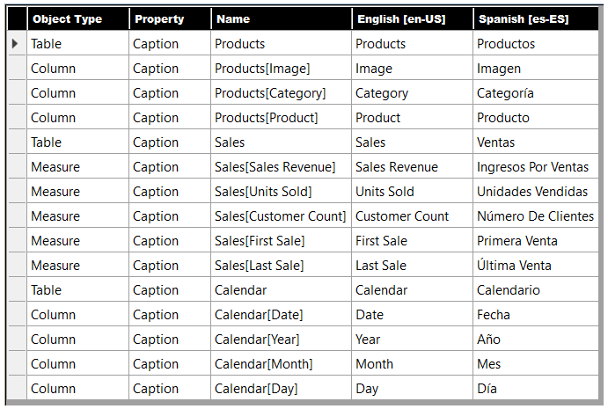
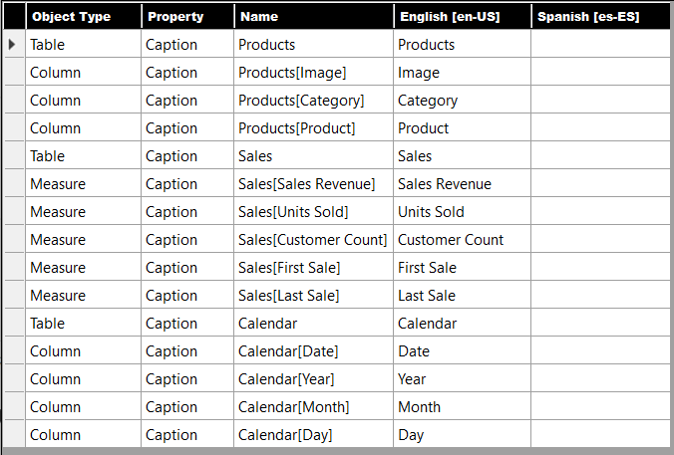
Generating Machine Translations
Translations Builder supports generating machines translation
Machine translations generated using Azure Translator Service
Translations Builder provides commands to automatically populate metadata translations
Translations Builder
Azure
Translator
Service

Slide 31
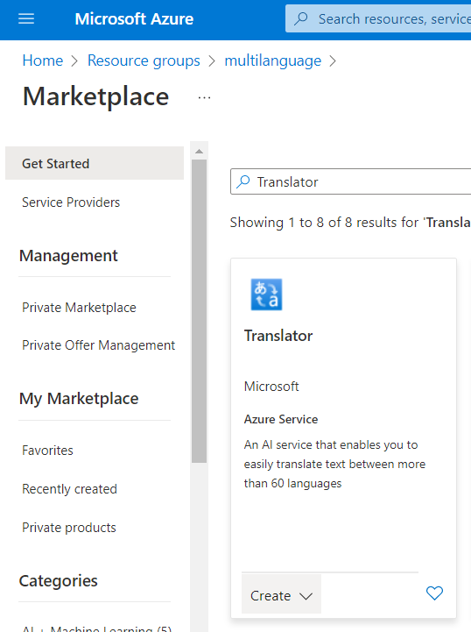
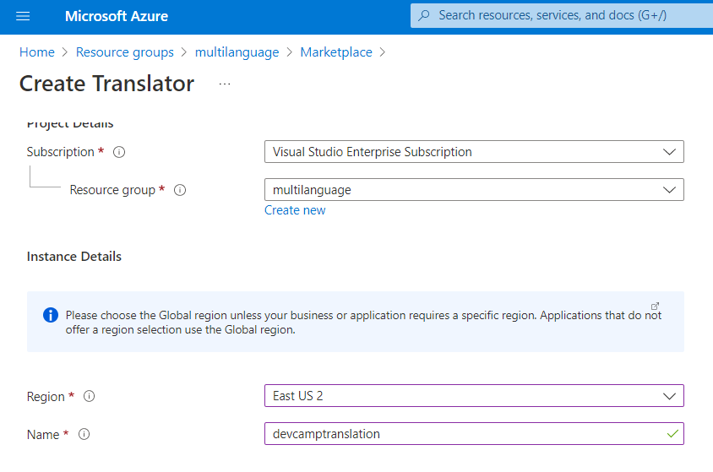
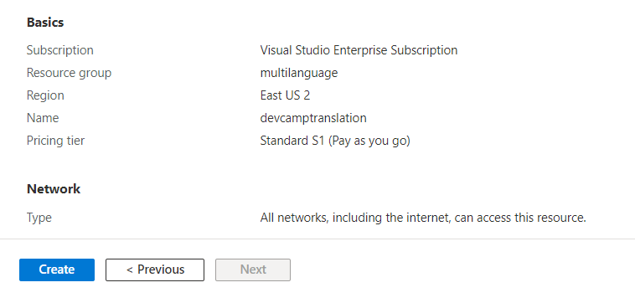
Creating an Instance of Azure Translator Service
Creating an instance of Azure Translator Service requires an Azure subscription
Search for Translator in Azure marketplace
Configure Azure Translator Service with Region, Name and Pricing tier
Click Create

Slide 32
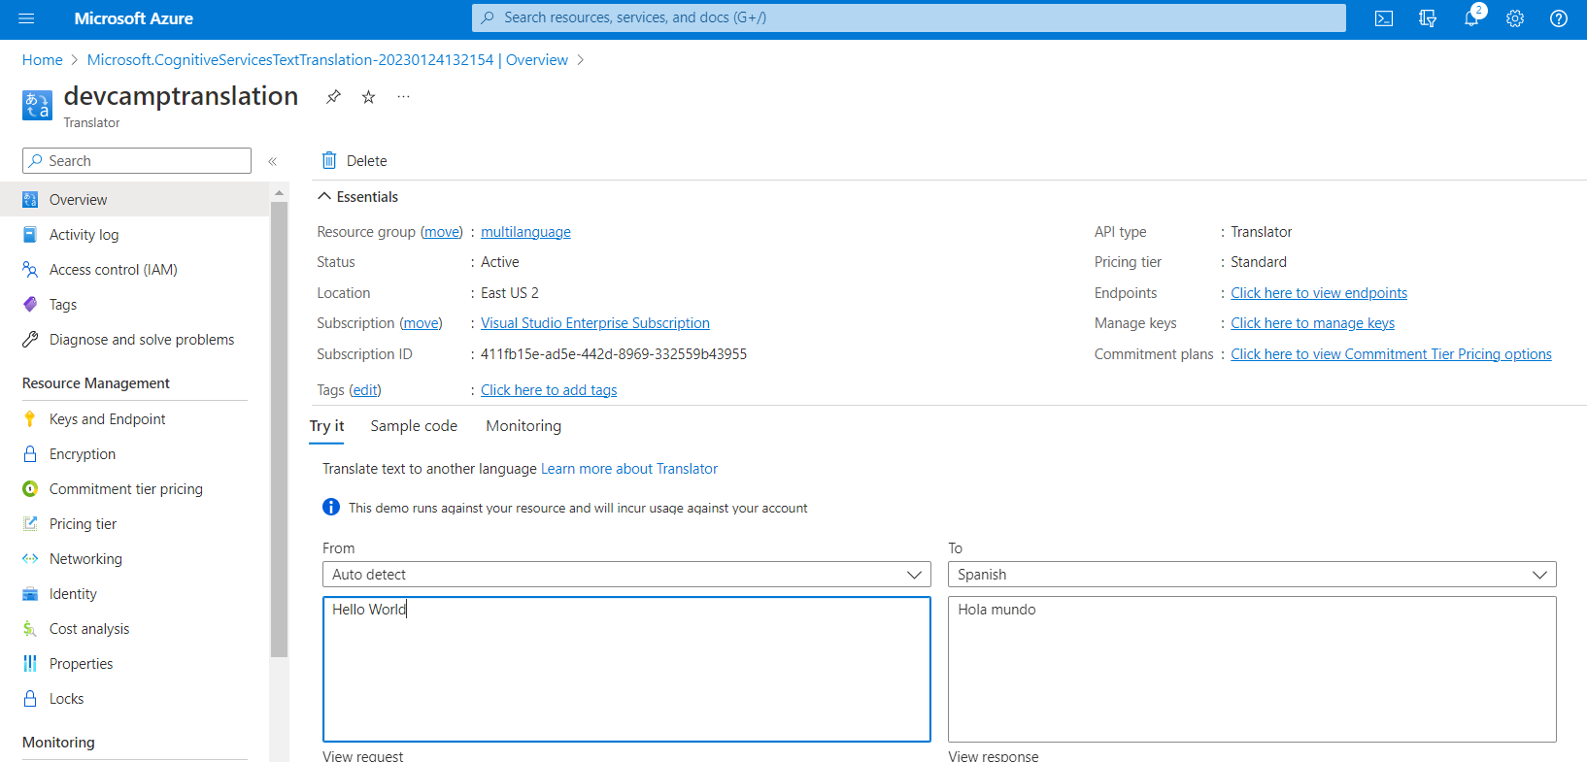
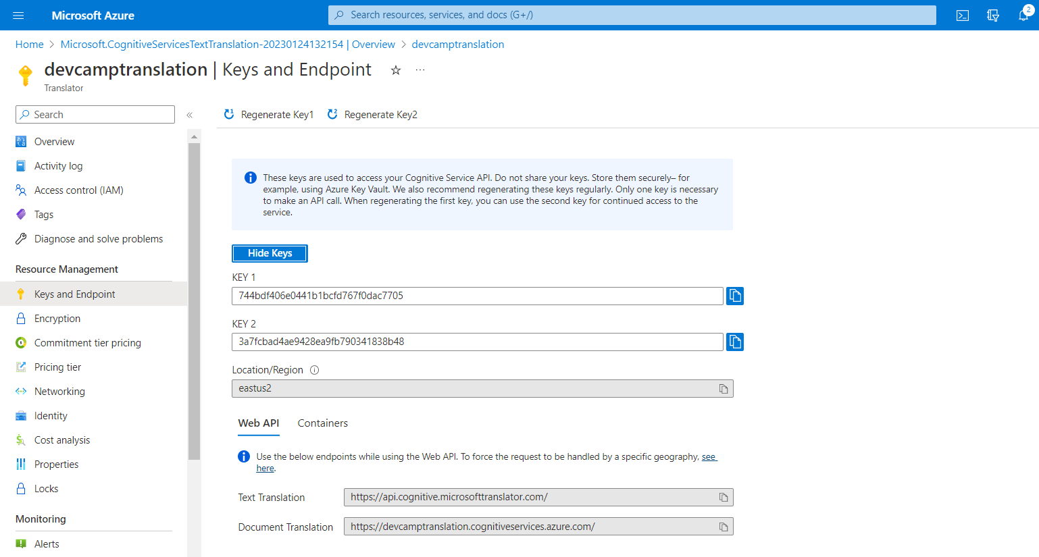

Getting a Key and Location for Azure Translator Service

Slide 33


Configuring Support for Azure Translator Service
Translations Builder requires key and location to use Azure Translator Service
Requires Azure subscription to obtain key and location for Azure Translator Service instance
Translations Builder provides Configuration Options for Azure Translator Service
Once configured, Translations Builder enables commands to generate machine translations

Slide 34



Generating Machine Translations – Single Language
You can generate translations for a single column at a time
Set language in dropdown menu
Click Generate Translations button

Slide 35

Commands to Generate Machine Translations
Generate Translations (single language)
Adds or overwrites all translations in column for language
Fill Empty Translations (single language)
Adds translations only to empty cells in column for language
Generate All Translations (all languages)
Adds or overwrites all translations in all secondary language columns
Fill Empty Translations (all languages)
Adds translations only to empty cells in all secondary language columns

Slide 36


Quickly Generate Translations for Single Row
Translations Builder supports generating translations for single row in grid
Allows user to generate machine translations for single dataset object at a time
Double-click on row header to execute command

Slide 37
Agenda
Building Multi-language Reports in Power BI
Creating and Testing Metadata Translations
Generating Machine Translations
Creating and Testing Report Label Translations
Creating a Workflow To Integrate Human Translations
Implementing Data Translations using Field Parameters
Implementing Data Translations for a Calendar Table

Slide 38

Implementing Report Label Translations
Report labels do not have associated dataset object
That makes report label translations harder to implement than metadata translations
Power BI provides no built-in feature to track or integrate them
Best practice implementations rely on USERCULTURE function and dynamic translations
Use SWITCH function with language identifier to dynamically return correct translation
Pattern falls back on the default language (en) when there is no match

Slide 39

Automatic Localization of Visual Titles
Common Power BI report design techniques do not support localization
Using textboxes or buttons with hard-coded text values
Displaying page tabs to the user
Hard-coding text values for Title property of a visual
By default, a Cartesian visuals assigns dynamic value to Title property
Dynamic value for Title parsed together using the names of the columns and measures
Dynamic Title property automatically supports localization once metadata has been added
Language | Visual Title
English (en-US) | Sales Revenue by Country and Year
Spanish (es-ES) | Ingresos por ventas por país y año
French (fr-FR) | Chiffre d’affaires par pays et année
German (de-DE) | Umsatz nach Land und Jahr
Dutch (nl-NL) | Omzet per land en jaar

Slide 40


Translations Builder uses Localized Labels Table Strategy
Translation Builder uses innovative approach to track & surface report label translations
Strategy based on creating hidden table in data model named Localized Labels
For each report label, a new measure is added to Localized Labels table
Translations for report labels tracked as metadata translations for their associated measure
Localized Labels table is one exception where hidden datasets objects are displayed in grid

Slide 41


Creating the Localized Labels Table
Translations Builder provides all interaction with Localized Labels table
No need to interact with Localized Labels table using Power BI Desktop
Use Create Localized Labels Table command to add table in data model
Dialog prompts users if they need more info on Localized Labels table

Slide 42



Adding Report Labels to the Localized Labels Table
Add new report labels using menu command of Ctrl+A keystroke combination
Add report label one at a time
Use Advanced Mode to add batch of report labels at once

Slide 43


Report Label Translation Editing Experience
Translations Builder merges report label translations with metadata translations
Report label translation stored in same format and in same PBIX file as metadata translation
Report label translation created and edited using same experience as metadata translations
Translations Builder can generate machine translations for report labels

Slide 44


Generating the Translated Localized Labels Table
Localized Labels table does not provide easy way to surface report labels in report
Translations for Localized Labels table used to generate Translated Localized Labels table
Table created and updated using Generate Translated Localized Labels Table command
Unlike Localized Labels table, the Translated Localized Labels table is visible in Report view

Slide 45



Inspecting Measures in Translated Localized Labels Table
Measures in Translated Localized Labels table visible in Fields list in Report view
Measures in Translated Localized Labels implement dynamic translations pattern

Slide 46

Surfacing Report Labels on a Report Page
Surface report labels by configuring visual and shape properties with label measures
You can use a localized report label anywhere you can use a measure
For example, add a Card visual and then add Product Sales Report Label to Fields data role

Slide 47







Using Shapes to Surface Report Labels
Shapes such as Rectangle provide great way to surface report labels

Slide 48


Localizing the Page Navigation Menu
Report page tabs do not support localization
Hide all pages in Report view except for the main landing page
Create report bookmarks for page navigation in Bookmarks pane
Create navigation menu using buttons which apply bookmarks to navigate between pages

Slide 49

Configuring Buttons with Localized Report Labels
Configure Text property for Button with localized label measure

Slide 50
Agenda
Building Multi-language Reports in Power BI
Creating and Testing Metadata Translations
Generating Machine Translations
Creating and Testing Report Label Translations
Creating a Workflow To Integrate Human Translations
Implementing Data Translations using Field Parameters
Implementing Data Translations for a Calendar Table

Slide 51




Using Translation Sheets to Integrate Human Translations
Translations Builder uses translation sheets to integrate work of human translators
Translation sheets are CSV files generated using Export Operations
Translation sheets sent to human translators
Human translators update translations sheets and return them
Translations from updated translation sheet integrated back into data using Import Operation
Outbox
Project1-Translations-Spanish.csv
Export Translation Sheet
Project1-Translations-German.csv
Export Translation Sheet
Inbox
Import Translation Sheet
Project1-Translations-Spanish.csv
Import Translation Sheet
Project1-Translations-German.csv

Slide 52

Export and Import Commands
Translations Builder provides commands for Import and Export operations
Three commands to export translations to generate translation sheets
All export commands can be configured with or without Open in Excel option
One command to import translations from any type of translation sheet

Slide 53



Configuring Target Folders for Outbox and Inbox
Open Configure Settings dialog
Configure target folders on local hard drive for Outbox and Inbox

Slide 54


Exporting a Translation Sheet for a Single Language
Select a language and click Export Translation Sheet
Enabling Open in Excel option make it possible to view contents of translations sheet

Slide 55


Exporting Translation Sheets for All Languages at Once
Create all single-language translation sheets at once
Disable Open in Excel option and click Export All Translation Sheets
All single-languages translation sheets are generated at once for distribution to translators

Slide 56

Exporting a Master Translation Sheet
Master translation sheet contains columns for all languages in PBI project
Generate a master translations sheet by clicking Export All Translations
Master translation sheet can serve as backup of all translation work

Slide 57


Importing Translations Sheets
There is a single command to execute all Import operations
Click Import Translations
Select a source translations sheet and click Open

Slide 58
Enterprise Level Management of Translations
Translations can be moved between PBIX projects using master translation sheets
Logic built into Import operation
Include metadata translations for any dataset objects that exist in target dataset
Ignore metadata translations for any dataset objects that do not exist in target dataset
Add secondary languages and their translations if language does not exist in target dataset
Add Localized Labels table and report label translations if they do not exist in target dataset
PBIX Project 1
Master
Translation
Sheet
PBIX Project 2
Export Operation
Import Operation

Slide 59
Enterprise Level Management
It’s possible to create and maintain enterprise-level master translation sheet
Initialize new PBIX projects with a reusable set of localized report labels
Initialize new PBIX projects with translations for common schema of dataset objects
New PBIX
Project 1
Enterprise Master
Translation Sheet
Import Operation
Import Operation
New PBIX
Project 2
Import Operation
New PBIX
Project 3

Slide 60
Agenda
Building Multi-language Reports in Power BI
Creating and Testing Metadata Translations
Generating Machine Translations
Creating and Testing Report Label Translations
Creating a Workflow To Integrate Human Translations
Implementing Data Translations using Field Parameters
Implementing Data Translations for a Calendar Table

Slide 61
Data Translations Implementation Journey
Start by asking yourself this question
Should I even implement data translations in the first place?
If the answer is No
Pat yourself on the back. You’re all done
If the answer is YES
Learn how to extend the datasource with extra data translation columns
Learn how to create and configure Field Parameters
Learn how to synchronize Field Parameters using a filtering strategy
Learn how to set the filter to select the correct language when the report loads

Slide 62

Scenario 1 – Data Translations Not Required
All users associated with a single database instance speaker the same language
This scenario requires metadata translations and report label translations
This scenario does not require data translations

Slide 63

Scenario 2 – Data Translations Required
Users who speak different languages are associated with a single database instance
This scenario requires metadata translations and report label translations
This scenario does require data translations

Slide 64

Other Questions To Ask When Implementing Data Translations
How hard will it be to translate various text values to secondary languages?
Easy: translating short strings (product names and product categories)
Hard: translating longer strings with complete sentences & paragraphs (product descriptions)
How many distinct column values will require translation?
Can your translation team handle editing translation volume when tables reach 10,000+ rows
Do you have a post-deployment translation process in-place as new rows are added?
When a new product is added to the database, when and how are data translations generated?

Slide 65



Patterns for Implementing Data Translations
There are common industry patterns in table design to implement data translations
Add an extra column for each language to track data translations
Add an extra row for each language to track data translations
In the past, it’s been challenging to implement data translations by adding columns
Power BI does not support dynamic evaluation for calculated columns
Using row replication is was the best way to implement data translations
Row replication strategy based on row-per-language with filtering
Field Parameters Rule
Don’t use Row Replication
It’s obsolete & inefficient
ETL with Content Translation

Slide 66


Extending the Datasource with Data Translation Columns
Data translation implementation starts with modifying datasource schema
Tables must be extended by adding one data translation column per language
Products table extended with 4 columns with translated product names
Categories table extended with 4 columns with translated product category names

Slide 67


What is a Field Parameter?
Field Parameter is a table in which each row represents a field
You can think of a Field Parameter as a collection of fields
The rows of a Field Parameter can be filtered
You can think of Field Parameter as a filterable collection of fields
Field Parameter can be configured to act as a column selector
Exposed as single field for report layout that can be switched between columns (i.e. languages)
column
selector

Slide 68


Creating a Field Parameter
Select New parameter > Fields in the Modeling tab
Enter Name and add fields to field collection

Slide 69


Inspecting New Field Parameter in Report View
New Field Parameter is created as a table visible in Report view
Field Parameter exposes on field visible in Report view

Slide 70


Understanding Field Parameters
Experiment: test how Field Parameter allows you to select fields
Add Field Parameter with slicer
Add a Table visual on report page
Add visible field from Field Parameter into Columns data role of Table visual
Select one column at a time from slicer to select single column

Slide 71




Localizing Field Names in a Field Parameter
Field names in a Field Parameter originally based on datasource column names
Names of fields are hard-coded in DAX expression and are not localized
Update field names in DAX expression to support localization

Slide 72



Inspecting Field Parameter in Data View
A Field Parameter has two additional hidden columns
There is one column for fields and another column for sort order
Columns in a Field Parameter can (and should) be renamed

Slide 73




Extending Field Parameter with LanguageId Column
You can modify Field Parameter DAX expression to add new columns
New column named Value4 should be renamed to LanguageId

Slide 74


Cleaning Up The Field Parameter
Set Sort by column for LanguageId column
Hide LanguageId column from Report view

Slide 75


Adding The Languages Table
Languages table added to data model to filter and synchronize Field Parameters
Languages table created with Power Query and custom M code
Languages table becomes part of data model

Slide 76


Filtering Field Parameters with the Languages Table
Create one-to-one relationship between Languages table and Field Parameter
Relationship based on LanguageId column
Selecting single row in Languages table selects single language column in Field Parameter

Slide 77


Adding a Second Field Parameter for Category Names
Add and configure second Field Parameter using the same steps as first
Create relationship between new Field Parameter and Languages table

Slide 78

Testing Data Translations in Power BI Desktop
You can test data translations while working in Power BI Desktop
You can test data translations – but not metadata translations or report label translations
Configure visuals to use fields from Field Parameters
Switch filter on Languages table to switch between languages during testing

Slide 79

Updating the Report Layout
Update all visuals in report to use Field Parameters when displaying text values

Slide 80


Creating Report Bookmarks to Select Language
How do you filter Languages to select the correct language when a report loads?
Filter Languages table with a report bookmark
Filter Languages table with an RLS rule
Filter Languages table using Power BI embedding
For the scenario in the hands-on lab, we’ll use report bookmarks
Create one report bookmark for each language
Enable Data behavior and disable Display and Current page behaviors

Slide 81



Discovering Report Bookmark IDs in the Browser
Use bookmarkGuid parameter in report URL to apply bookmark as report loads
Discover values for bookmarkGuid parameter by applying report bookmarks in browser

Slide 82



Testing Reports with Data Translations in Power BI Service
Configure browser bookmarks with language parameter and bookmarkGuid parameter

Slide 83

You’re Still Not Done
Data translations are required for the calendar names of months and days

Slide 84
Agenda
Building Multi-language Reports in Power BI
Creating and Testing Metadata Translations
Generating Machine Translations
Creating and Testing Report Label Translations
Creating a Workflow To Integrate Human Translations
Implementing Data Translations using Field Parameters
Implementing Data Translations for a Calendar Table

Slide 85

Starting Point for Calendar Table
This Calendar table does not support data translations (yet)
DAX expression for calculated table evaluated at dataset load time
All calendar month names and day names are always displayed in English

Slide 86



Implementing Data Translations for Month and Day Names
Solution based on using Power Query to generate translation tables
Queries that generate translation tables use Languages query output as their source
Queries generate translations by passing DefaultCulture value to M Date functions
Query output generates a separate column for each row in Languages table
Languages
Power Query Transforms
Translated Month Names Table
Translated Day Names Table

Slide 87








Translating Month and Day Names
Month names translated by passing DefaultCulture value to Date.MonthName
Day names translated by passing DefaultCulture value to Date.DayOfWeekName

Slide 88



Query for Translated Month Names Table
Translated Month Names Table query

Slide 89


Query for Translated Day Names Table
Translated Day Names Table query

Slide 90




Configuring Translation Tables in Data Model
Steps to configure translation tables in data model
Create relationship between Calendar and Translated Day Names Table using DayNumber
Create relationship between Calendar and Translated Month Names Table using MonthNumber
Hide Translated Day Names Table and Translated Month Names Table from Report view

Slide 91


Configuring Sort by Columns in Translation Tables
Configure Sort by column to DayNumber for columns in Translated Day Names Table
Configure Sort by column to MonthNumber for columns in Translated Month Names Table

Slide 92





Creating Field Parameter to Translate Month Names
Field Parameters used to add column selector on top of translation tables
Creating Field Parameters for calendar translation tables
column
selector
column
selector

Slide 93




Translated Month Names – Field Parameter
Configuration steps for Translated Month Names
Replace DAX to localize column names and to add language identifier as forth column
Rename columns to improve readability
Hide LanguageId column from Report view and set its Sort by column to SortOrder

Slide 94




Translated Day Names – Field Parameter
Configuration steps for Translated Day Names
Replace DAX to localize column names and to add language identifier as forth column
Rename columns to improve readability
Hide LanguageId column from Report view and set its Sort by column to SortOrder

Slide 95

Creating Relationships with Languages Table
Field Parameters must be synchronized with Languages table
Create relationships based on LanguageId column

Slide 96

Configuring Column Chart with Translated Month Names

Slide 97

Configuring Column Chart with Translated Day Names

Slide 98

Configuring Matrix with Translated Month & Product Names

Slide 99




Testing in Power BI Service

Slide 100
Look at all you’ve learned
Building Multi-language Reports in Power BI
Creating and Testing Metadata Translations
Generating Machine Translations
Creating and Testing Report Label Translations
Creating a Workflow To Integrate Human Translations
Implementing Data Translations using Field Parameters
Implementing Data Translations for a Calendar Table

Slide 101
Building Multi-language Reports for Power BI in 2023 Thanks for Watching

